Slide 1

A Project On AUTOMATION TESTING ON bigbasket WEBSITE
SONAL SAGAR SHINDE
Batch: 2022-7895
Course: SCHOOL OF COADING CERTIFIED SOFTWARE TEST ENGINEER
UNDER THE GUIDANCE OF- MRS.LENNA THORAT

Slide 2
AIM:
To do overall testing like functional testing on website to check quality of application.
To improve quality of website and saves time for manually doing this testing.
To check functionalities available on website.
SOFTWARE REQUIRMENTS:
Operating System: Windows 10
Browser: Latest version of Chrome
IDE: Eclipse IDE
Automation Tool: Selenium WebDriver

Slide 3
TOPIC INTRODUCTION:
To see what attracts visitors to your website
To make your website more user friendly and get referrals from happy customers
To have confidence that the technical part of your business runs smoothly
To make sure your website works fast and is reliable
To get a chance to eliminate unexpected errors

Slide 4
TOOL INFORMATION:
Selenium WebDriver
Open Source
Web Based Application
Free Automation Tool
Languages:- C#,Java,Python,Ruby

Slide 5
Method which I use:
Get(): To Access the Url
SendKeys(): for Sending Values
Drop-Down: The drop- down element as an instance of the Select Class
Three methods to use it for drop-down:
selectByVisibleText()
selectByIndex()
selectByValue()
navigate(): This method loads a new web page in the current browser window
Three methods to use it for navigate:
driver.navigate().forward();
driver.navigate().back();
driver.navigate().refresh();
Mouse Overing: This method move to mouse to the in-view center point of element

Slide 6
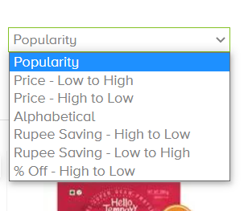
How to test dropdown:
selectByIndex(0);

Slide 7
CHALLENGES
driver.findElement(By.id("Fruits & Vegetables")).click();
driver.findElement(By.className("/html/body/div[1]/div[5]/footer/div[1]/div[3]/a[1]/img")).click();
This above two lines shows the challenge
I try to inspect element through this two locator by using id and name , but this is not work
So I imeplemented by other locators like xpath , linkText

Slide 8


